Slide 1
Why Have Economic Reforms in Mexico Not Generated Growth
Author: Timothy J. Kehoe and Kim J. Ruhl
Presenter: Zhijian Yang
Professor: Philip Dybvig

Slide 2


Introduction of paper
Kehoe: University of Minnesota, Federal Reserve Bank of Minneapolis, and NBER. Ruhl： University of Wisconsin Madison, and NBER
(National Bureau of Economic Research)
The data used in this paper are available at www.econ.umn.edu/~tkehoe and at www.kimjruhl. com.

Slide 3
Catalogue
1. Background
2. Debate in research history
3. Gains from trade
4. The Neoclassical Growth Model and Power of Productivity
5. Possible answers to the question and directions for future research
6. My opinion

Slide 4
Background: comparison between China and Mexico
SAME:
Reforms:
  Mexico: implemented a series of market-oriented reforms that culminated in the implementation of the North American Free Trade Agreement (NAFTA) in 1994.
  China: Reform and opening; joined WTO in 2001.
Large amount of merchandise trade and foreign direct investment(FDI) in 1995

Slide 5
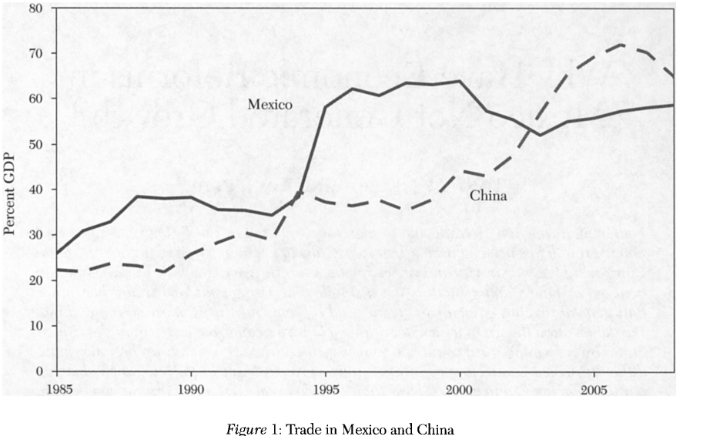
Background: comparison between China and Mexico

Slide 6
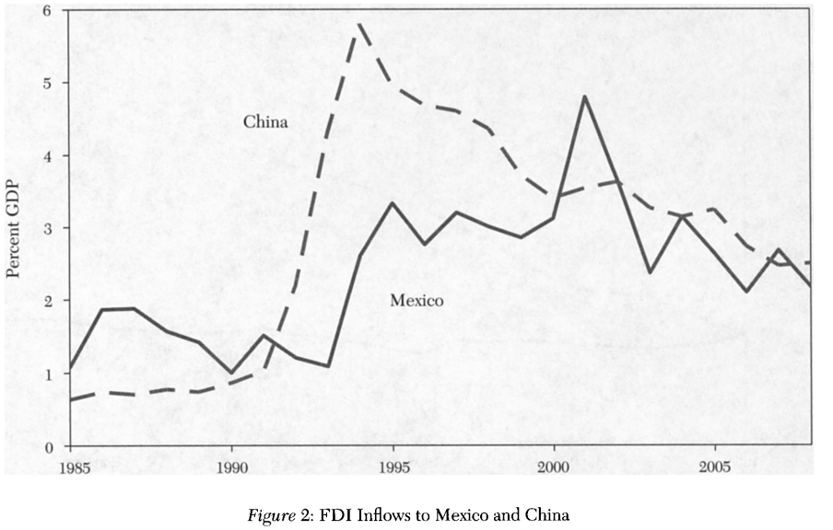
Background: comparison between China and Mexico

Slide 7
Background: comparison between China and Mexico
Difference:
Different economic growth rate:
  Real GDP per working-age person (from 1985 to 2008)
    China: 510%
    Mexico: 10%

Slide 8
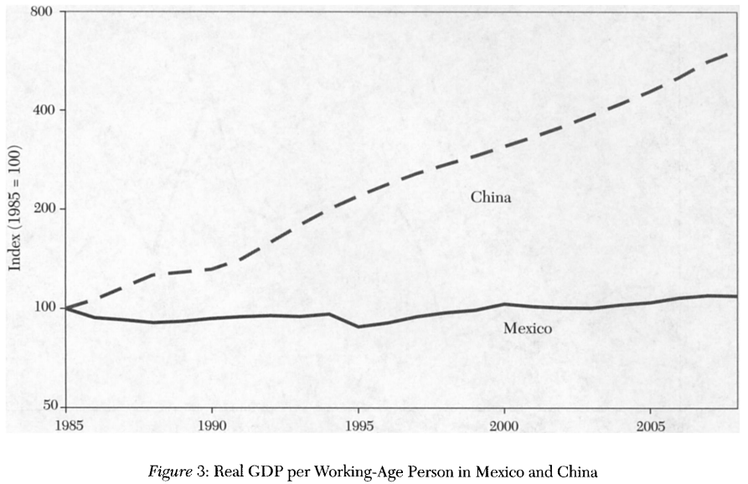
Background: comparison between China and Mexico

Slide 9
Background: comparison between China and Mexico
Difference:
Different economic growth rate:
  Real GDP per working-age person (from 1985 to 2008)
    China: 510%
    Mexico: 10%
  Merchandise trade and FDI in 2008

Slide 10
Debate in research history:
Cross-Country Growth Regressions
measures of openness in cross-country growth regressions:
Jeffrey D. Sachs and Andrew M. Warner (1995): Classify a country as closed if
  (1) a high average tariff rate
  (2) nontariff barriers on a large fraction of imports
  (3) a socialist economic system
  (4) a state monopoly over major exports
  (5) a high black-market premium
David Dollar and Aart Kraay (2004)： identify country as “globalizer” if
  significantly increased their ratios of trade to GDP between the late 1970s and the late 1990s

Slide 11
Debate in research history:
Cross-Country Growth Regressions
Whether the relationship between a country trade as a share of GDP and its growth rate is strong and robust or not
Whether the relationship between measures of policies related to openness and growth is robust or not
Whether researchers should be guided by a theoretical model or not

Slide 12
Debate in research history:
Studies of Mexico’s Stagnation and China’s Fast Growth
Mexico has an inefficient financial system and is lack of contract enforcement
Mexico has a rigid labor market
Producers in Mexico have less access to credit and technical assistant
China reallocates resources from inefficient firms to efficient firms within manufacturing sector
China’s reform attracts efficient foreign firms to invest in China
China has a strong central government
Counterview: Mexico has almost the same situation as China.
Possible reason: China is at a lower level of development.

Slide 13
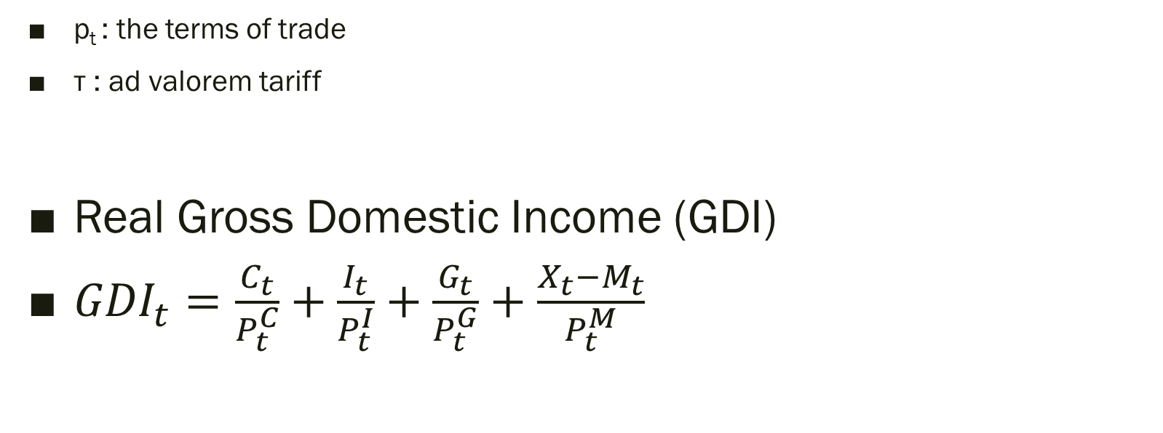
Gains from Terms of Trade
p_{t} : the terms of trade
τ : ad valorem tariff
Real Gross Domestic Income (GDI)
${GDI}_{t}=\frac{C_{t}}{P_{t}^{C}}+\frac{I_{t}}{P_{t}^{I}}+\frac{G_{t}}{P_{t}^{G}}+\frac{X_{t}−M_{t}}{P_{t}^{M}}$

Slide 14
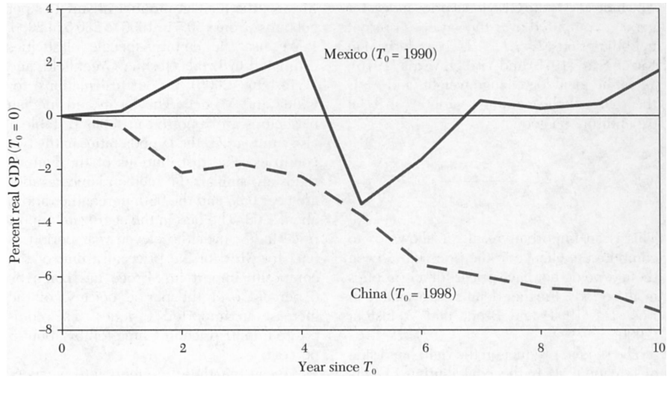
Gains from Terms of Trade

Slide 15
Gains from new varieties
Trade liberalization changes the composition of varieties that are available for consumption.
Capturing the impact of changing varieties is difficult with standard measurements
Construct a measure of bias in import price to compute gains from greater varieties

Slide 16
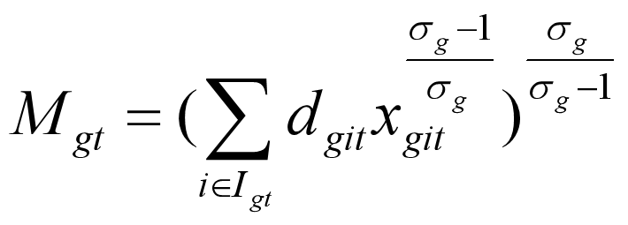
Gains from new varieties
Sub-utility of imported good g at time t is an aggregation of varieties
G: set of all imported goods
I_{gt}：set of all varieties available at time t
x_{git} : consumption of variety I of good g
d_{git} : a variety specific demand shifter
σ_{g} : elasticity of subsitution

Slide 17
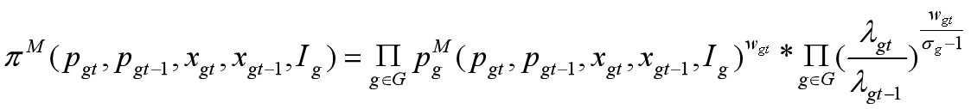
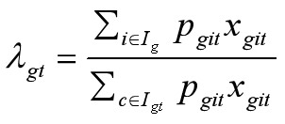

Gains from new varieties
Exact price index given the vectors of price p_{gt} and quantity x_{gt}
$p_{g}^{M}$: CES ideal price index
$I_{g}$：$I_{gt}∩I_{gt−1}$
$w_{gt}$: ideal log change weight
the share of the common varieties in total expenditure on good g

Slide 18
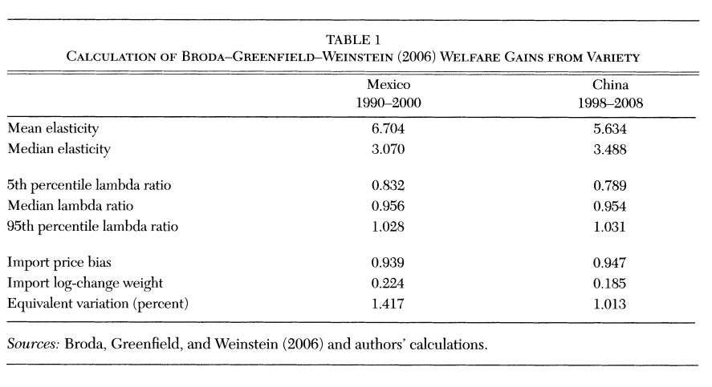
Gains from new varieties

Slide 19
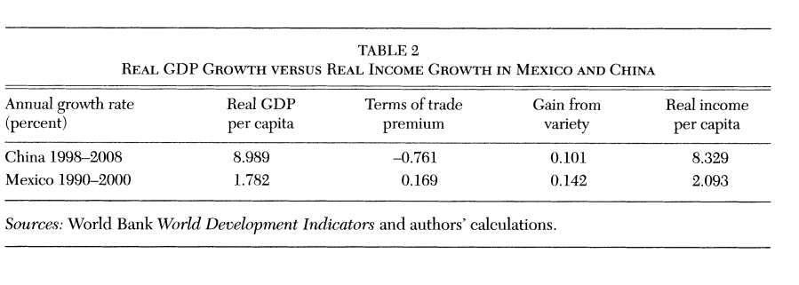
Gains from new varieties

Slide 20
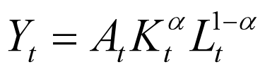
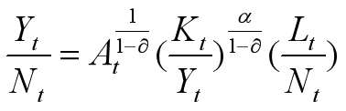
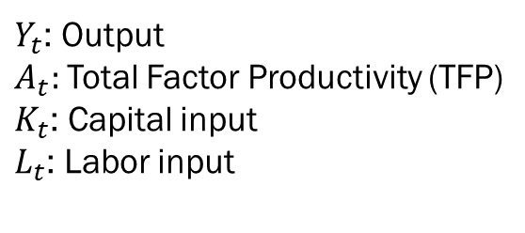
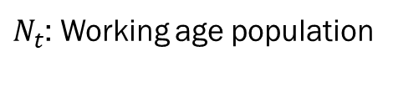
The Neoclassical Growth Model and
Power of Productivity
$Y_{t}$: Output
$A_{t}:$Total Factor Productivity (TFP)
$K_{t}$: Capital input
$L_{t}$: Labor input
$N_{t}$: Working age population

Slide 21
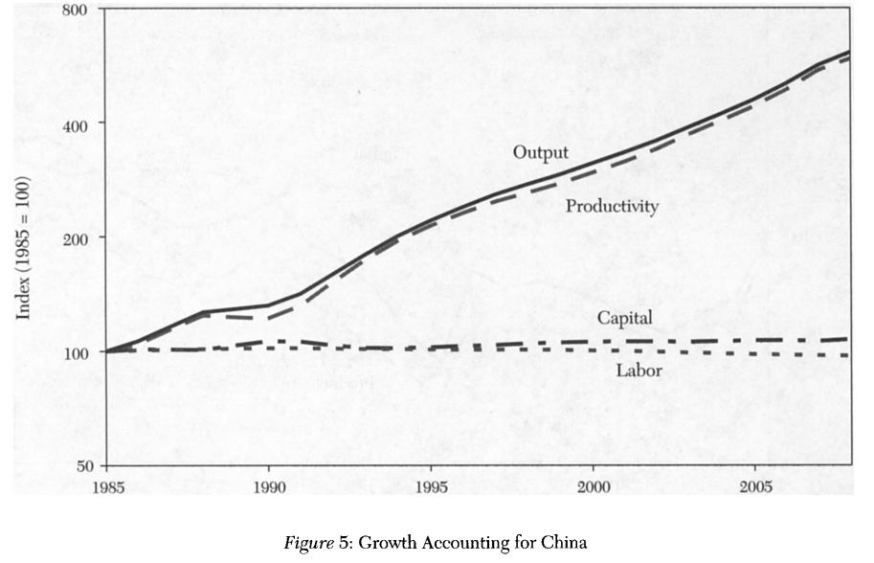
The Neoclassical Growth Model and
Power of Productivity

Slide 22
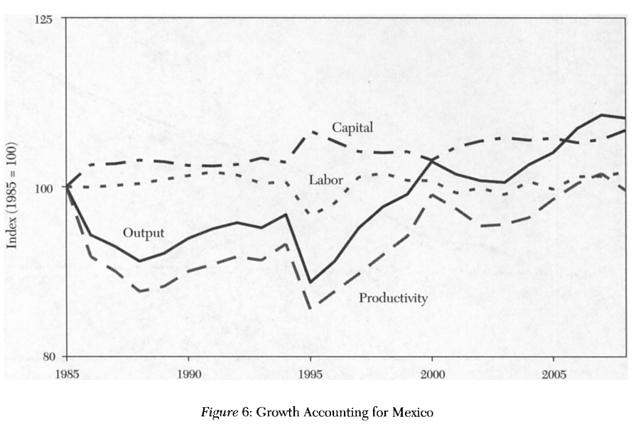
The Neoclassical Growth Model and
Power of Productivity

Slide 23
Possible answers to the question
1. It may be that the predominance of intrafirm trade between Mexico and the United States reduces the incentives toward competition and innovation that would arise from trade and foreign investment reforms.
2. Mexico is not experiencing the rapid catch-up growth that China is experiencing now because it already had this sort of catch-up during the period 1953-81

Slide 24
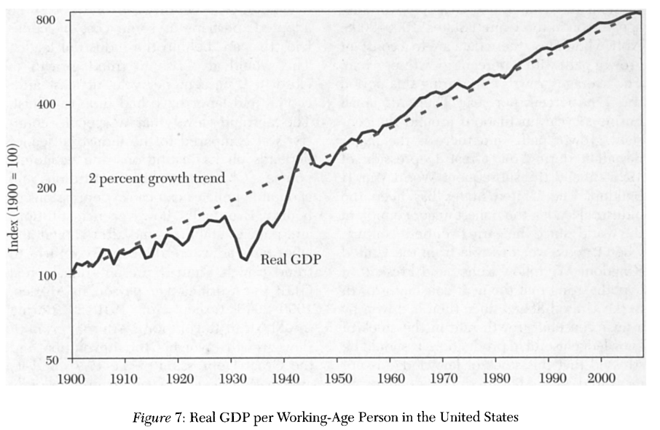
Possible answers to the question

Slide 25
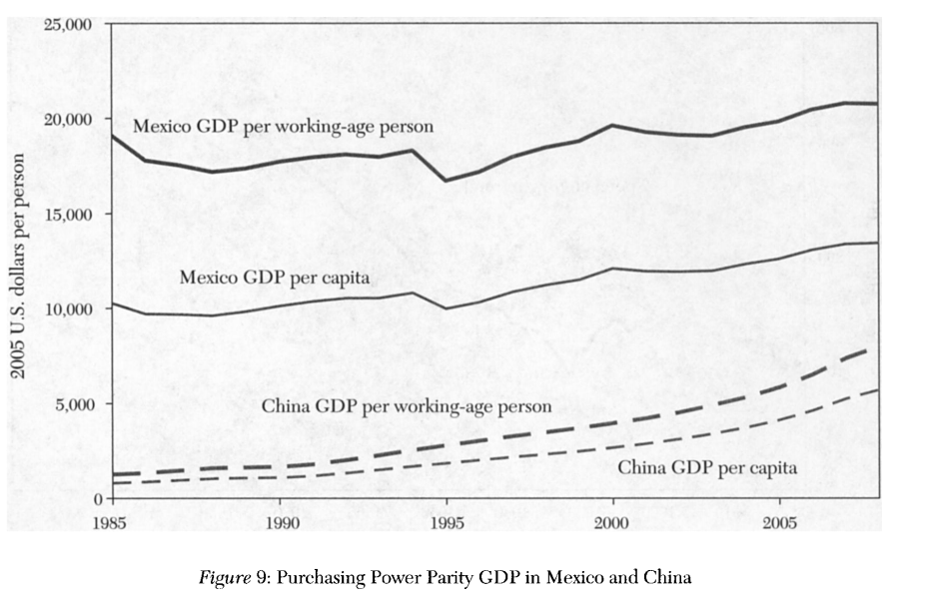
Possible answers to the question

Slide 26
My opinion
2010 Gross Domestic Income per capita:
China:7776 USD
Mexico: 11914 USD
China is at the same level as the data in Mexico in 1973, which is 7653 USD
China real GDP growth rate is around 6%
In 1973, real GDP growth rate in Mexico is fluctuating between 2% and 6%

Slide 27
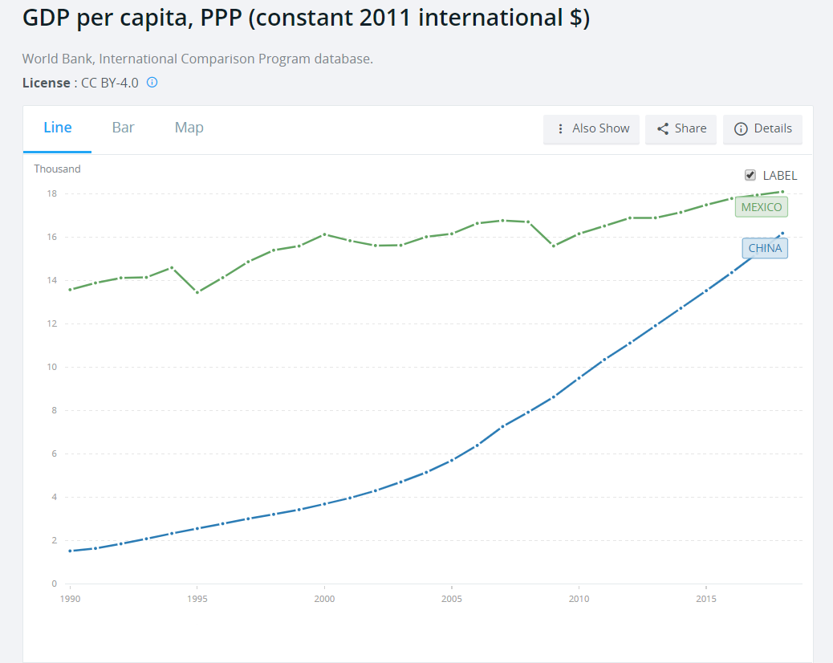

Slide 29
Thank you

